Slide 1
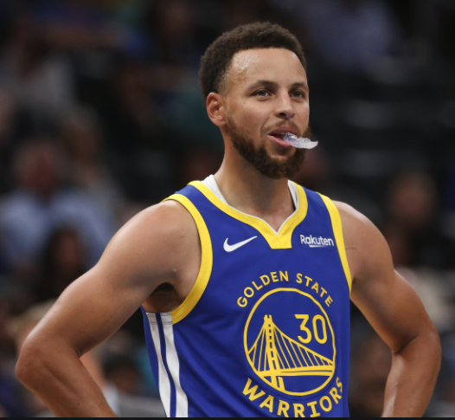
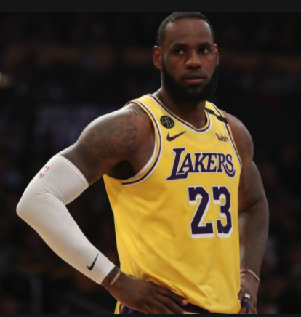
Web APIs & NLP: Warriors Subreddit vs Lakers Subreddit
Stephen Strawbridge, Cohort #1019

Slide 2
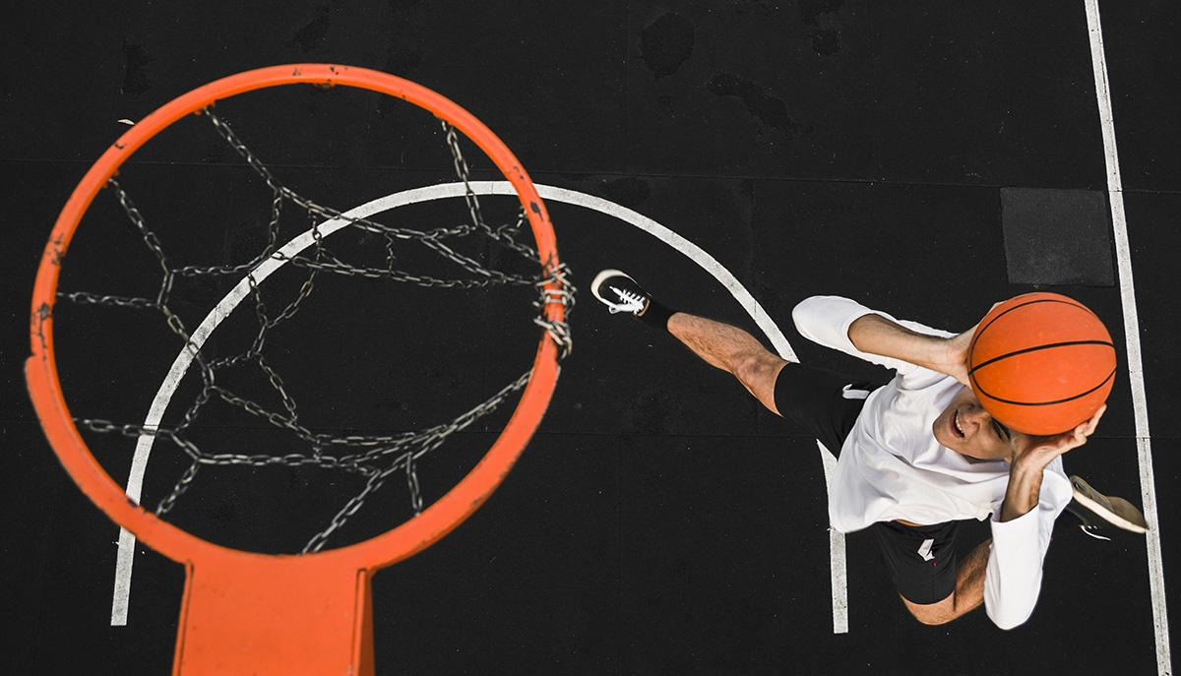
Problem: Which subreddit users are fans of the Warriors vs Lakers? Advertise accordingly!

Slide 3
Process Overview
01
02
03
04
Data Scraping/ EDA
(applied to both subreddits)
Random Forest Model
Naïve Bayes Model
Final Evaluation of
Best Model

Slide 4
Data Scraping
Key Considerations
Scraping only submissions
Size of web-scrape (5,000 rows)
time.sleep( ) function
Pulling duplicate rows

Slide 5
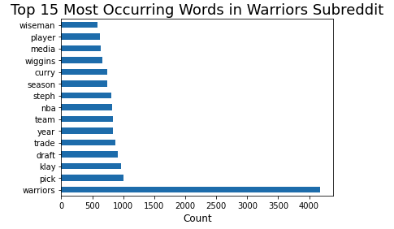
EDA- Warriors
No stop-words!

Slide 6
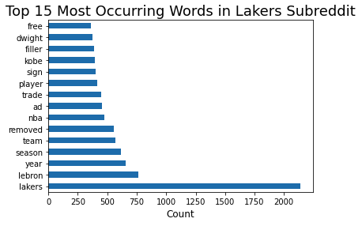
EDA - Lakers
No stop-words!

Slide 7
Random Forest Model (with TF-IDF Vectorizer)
N_estimators | Max_Features | Max_Depth | Ccp_Alpha
125 | auto | 70 | 0
Train Score = 99.73%
Test Score = 87.75%
Baseline accuracy = ~50%

Slide 8
Naïve Bayes Model (with TF-IDF Vectorizer)
Max_Features | Ngram Range | Stop words
9,000 | (1, 2) | My Stop_words Variable
Train Score = 92.84%
Test Score = 86.94%
Baseline accuracy = ~50%

Slide 9
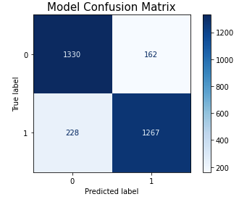
Further Analysis on Naïve Bayes Model
0 = Lakers
1 = Warriors

Slide 10
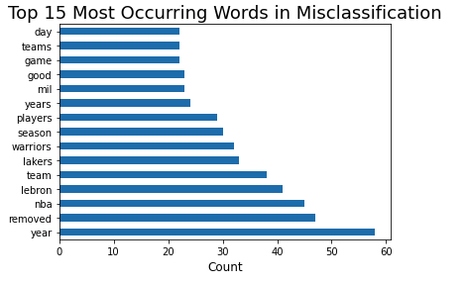
Analysis on Misclassified Posts

Slide 11
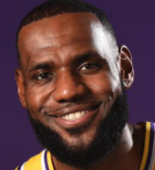
Conclusion and Recommendations
3. Optimal Advertisements
$$$!
2. Determine
fan loyalty
Use model on users other social media posts (Twitter, Facebook, etc)
1. Model = Success!
Trained model on our fan’s subreddit posts
Some limitations…..

Slide 12
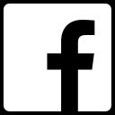
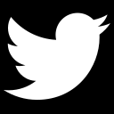
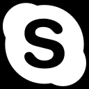
Thank you
stephenstrawbridge@gmail.com.com • +1 650 810 5681 • https://www.linkedin.com/in/stephen-strawbridge/
Questions?

Slide 13
Sources
Lebron James image:
https://twitter.com/i/events/1079453292684591109?lang=gl
Stephen Curry image:
https://bleacherreport.com/articles/2861888-stephen-curry-injury-latest-reports-on-warriors-stars-broken-hand

